Slide 1
Game World
Mentor-Manjusha W.

Slide 2
Introduction-
This project is created to develop a software for uploading games and quizzes which are entertaining as well as educational for all ages.
This software shall aim towards people who want to relax and have fun while learning and testing their skills in different areas.
In brief the goal is to have a game hosting website for people to upload and play games.
This software is created using “html”,”CSS”,”JS”,”PHP”.
The software has a functionality of multiuser login .

Slide 3
Scope-
The software is for users the to register and login.
The users can add new quizzes as well as play them.
The server side will be responsible for updating the website and its elements.
The users can upload lot of game so the website will stay fresh and growing.
The users play the games which will have a user scoreboard and they can compete with their own score as well as others.

Slide 4
Technologies Used
Front End:HTML,JAVASCRIPT,CSS
Back End:PHP,MYSQL
External Libraries:BOOTSTRAP,AWSOME-FONT

Slide 5
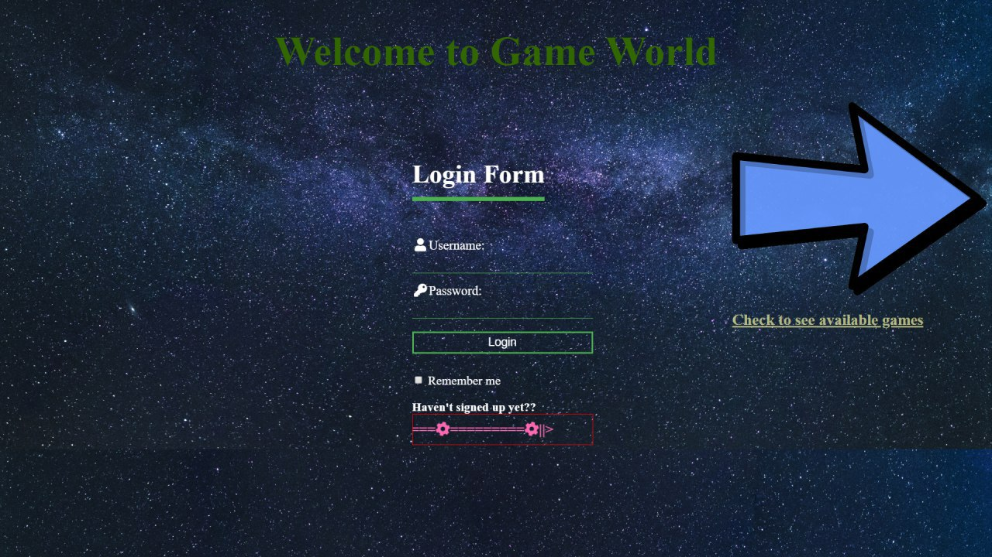
Working-

Slide 6
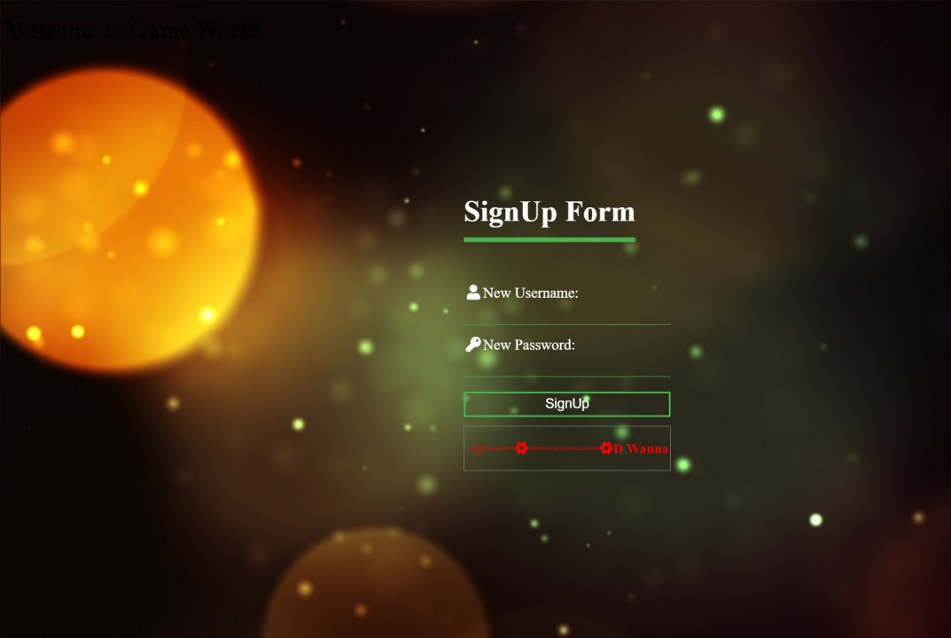
Registration Page-

Slide 7
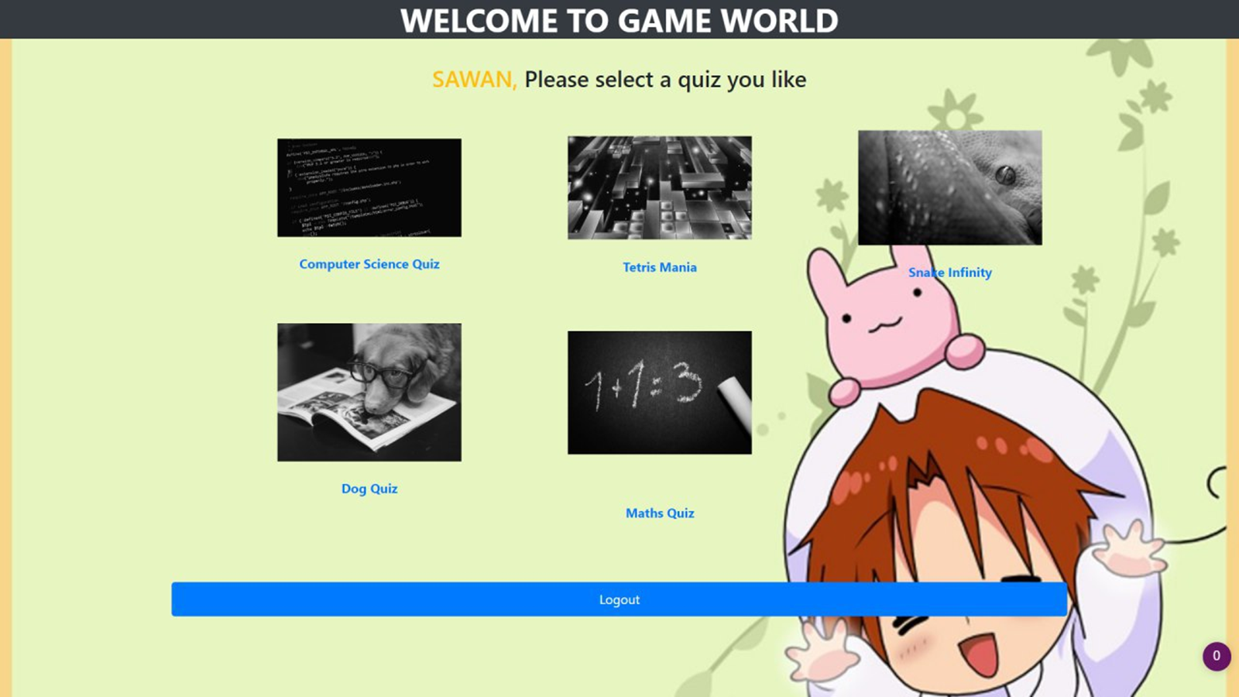
Home Page-

Slide 8
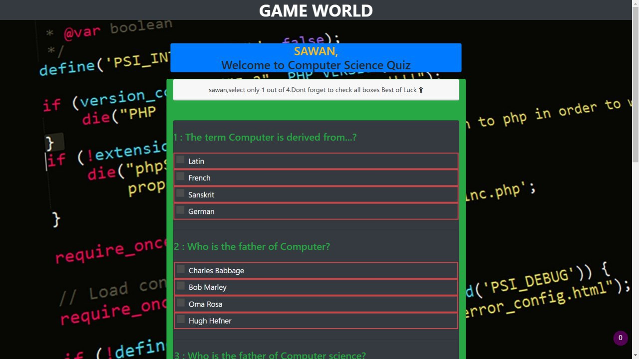
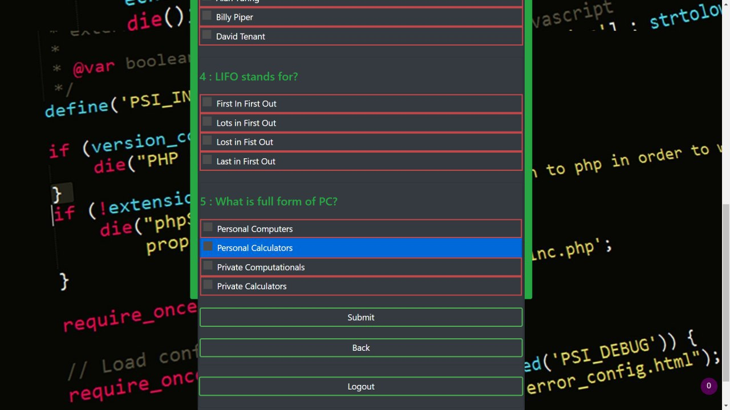
Quiz Demo

Slide 9
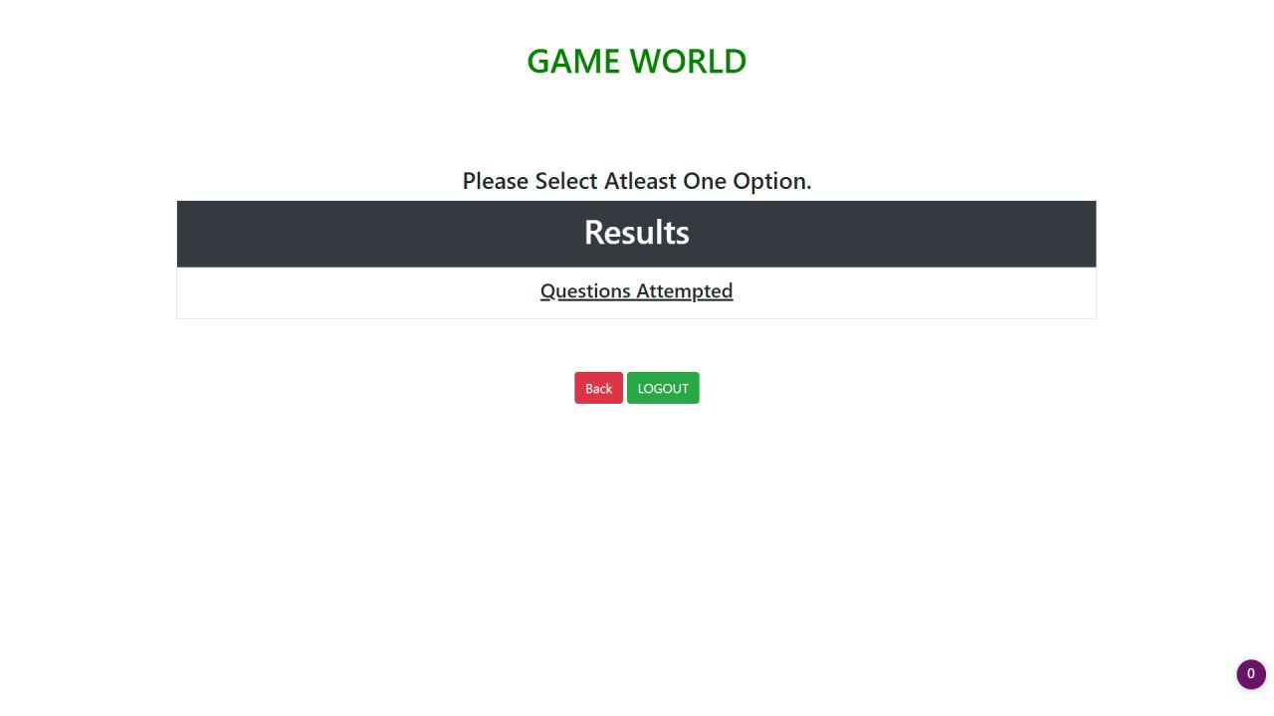
Result Page-

Slide 10
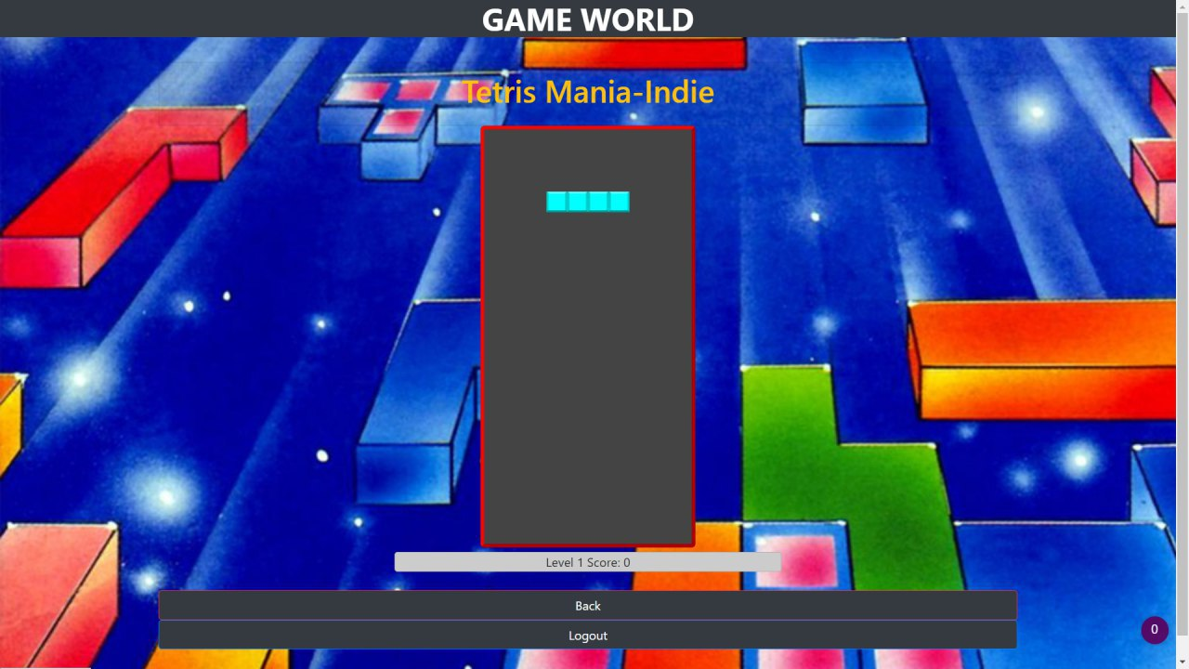
Tetris Mania-Indie

Slide 11
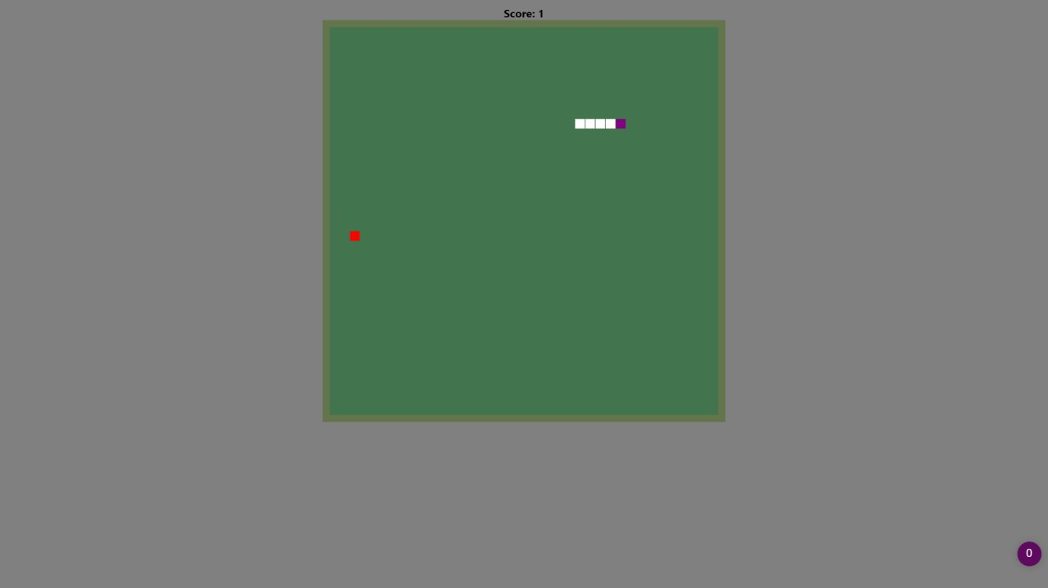
Snake Game-Infinity

Slide 12
Group Members-
Esha Goundi-Theme Design,DataBase
Sawan Pimpalkhare-Coding,UI,Database

Slide 13
ThankYou

